Slide 1
Vercel
Lecturer: Ngo Huy Bien
Software Engineering Department
Faculty of Information Technology
VNUHCM - University of Science
Ho Chi Minh City, Vietnam
nhbien@fit.hcmus.edu.vn

Slide 2

Objectives
To deploy a Node.js application to Vercel.

Slide 3

Contents

Slide 4

References

Slide 5
Vercel
https://vercel.com/
Vercel provides the developer tools and cloud infrastructure to build, scale, and secure a faster, more personalized web.

Slide 6
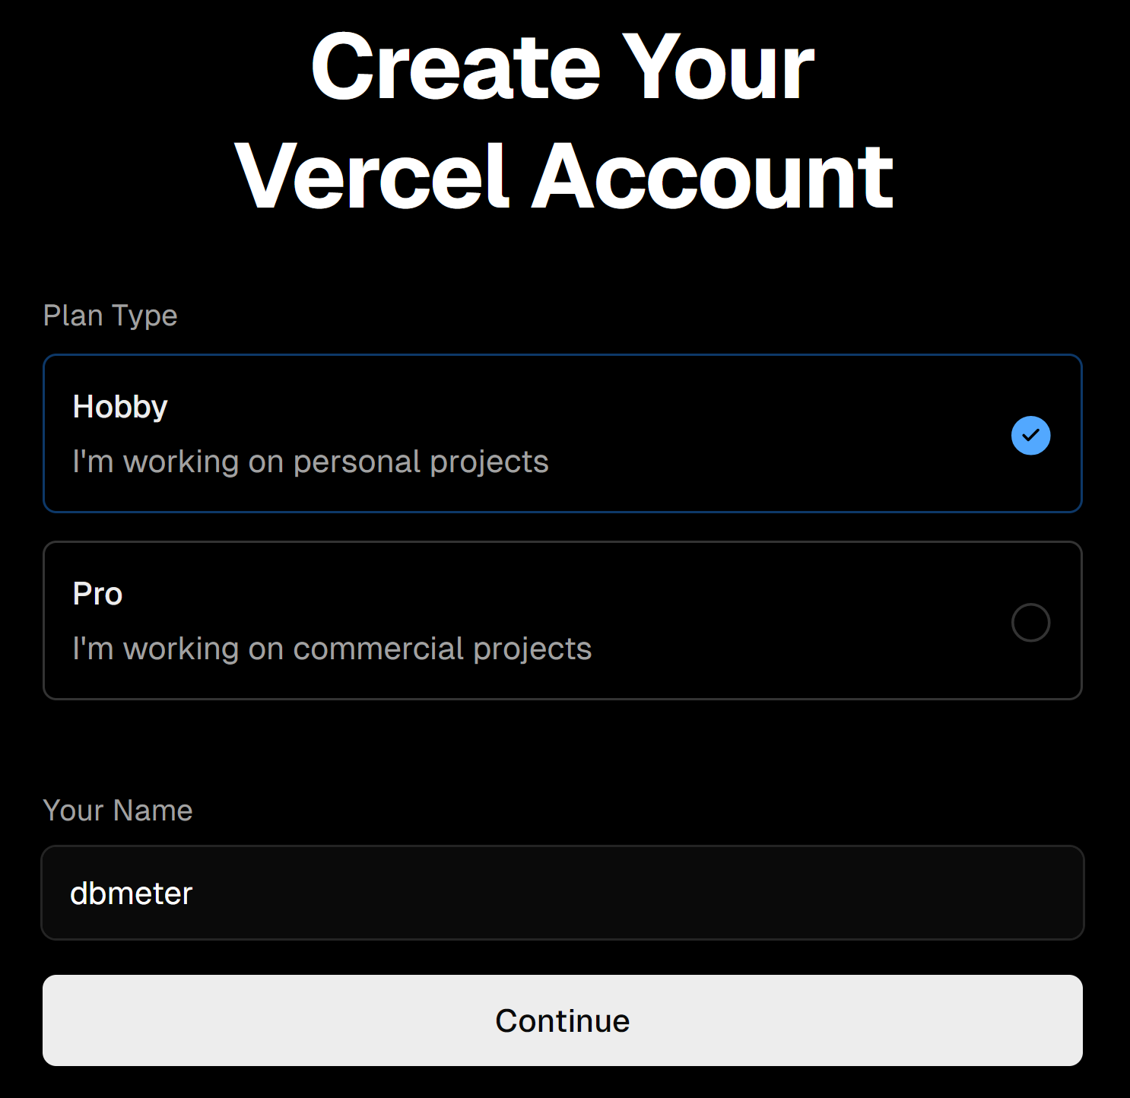
1. Create Account
https://vercel.com/signup

Slide 7
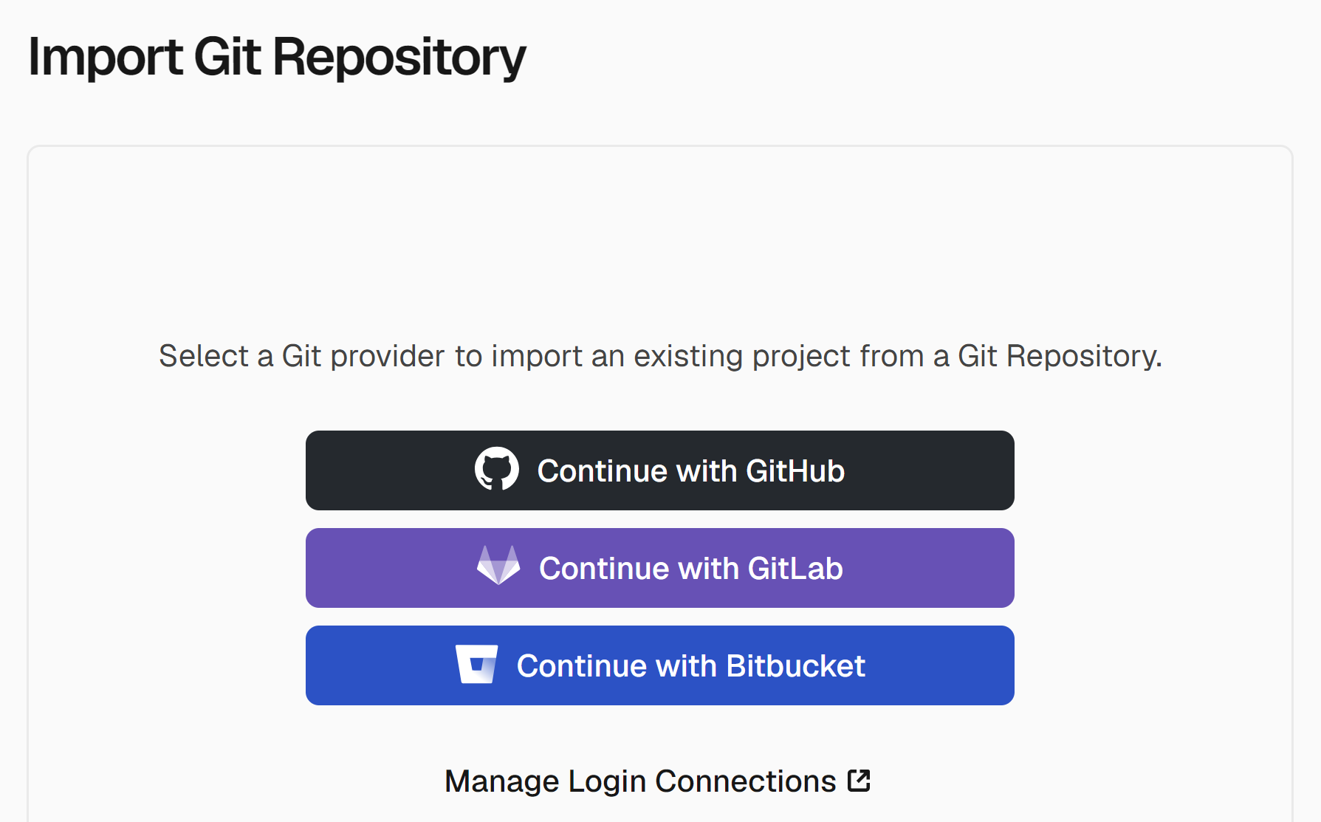
2. Import Git Repository
https://vercel.com/new

Slide 8
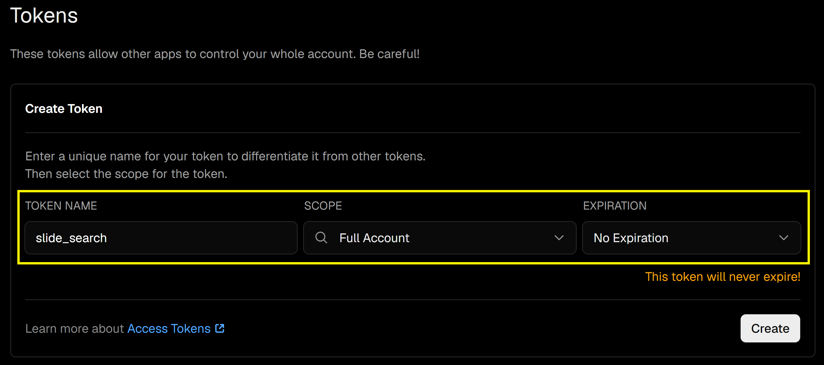
3. Create Full Access Token
https://vercel.com/account/tokens

Slide 9

Thank You & See You Again

